Slide 1

Project – Final Presentation
Software Engineering 2 – A.Y. 2015/2016
Jovanovic Milica 835953
Vidanovic Pavle 854472
POLITECNICO DI MILANO

Slide 2
RASD
Software Engineering 2 – A.Y. 2015/2016
POLITECNICO DI MILANO

Slide 3


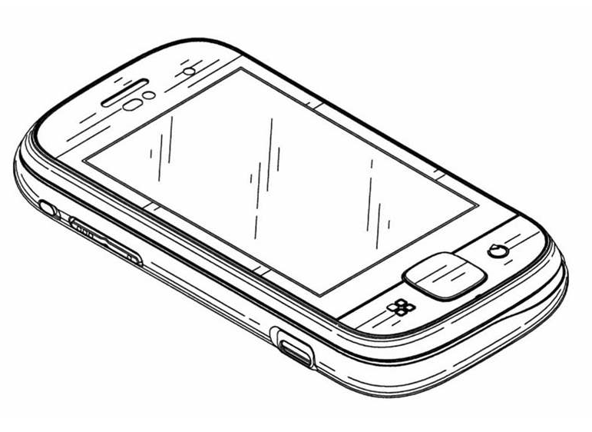

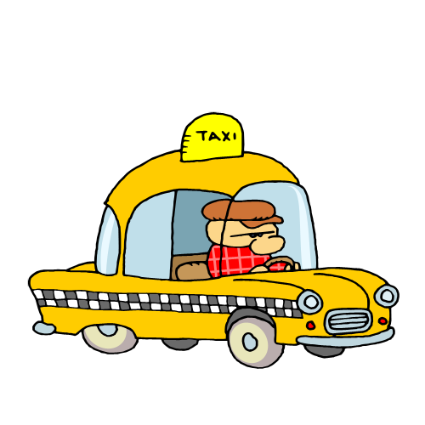

myTaxiService software application
Application similar to Uber, which makes the process of assigning an available taxi vehicle to possible passengers
POLITECNICO DI MILANO

Slide 4
Overall description
Stakeholders:
Company
- provided project specification
- expect it to be delivered in a way that satisfies given specification
- respecting the set deadlines and budget
Developer group
Taxi driver
- person working for the company that ordered the software product
Passenger
- person who need a ride to specific location
Actors:
Guest - person accessing a system that has either never registered of hasn't logged in yet
User - person already registered and logged into the system
Taxi driver - same as User, but can access to all features offered by the driver application
Admin - person responsible for handling reports, can ban users or driver from system
POLITECNICO DI MILANO

Slide 5
Overall description
Goals:
[G1] registering new user
[G2] login to existing user’s account
[G3] managing user's profile
[G4] requesting a taxi
[G5] reserving a taxi
[G6] canceling a ride
[G7] checking taxi availability around user
[G8] reporting a problem caused by passenger or taxi driver
[G9] confirming/declining a ride(taxi driver)
POLITECNICO DI MILANO

Slide 6

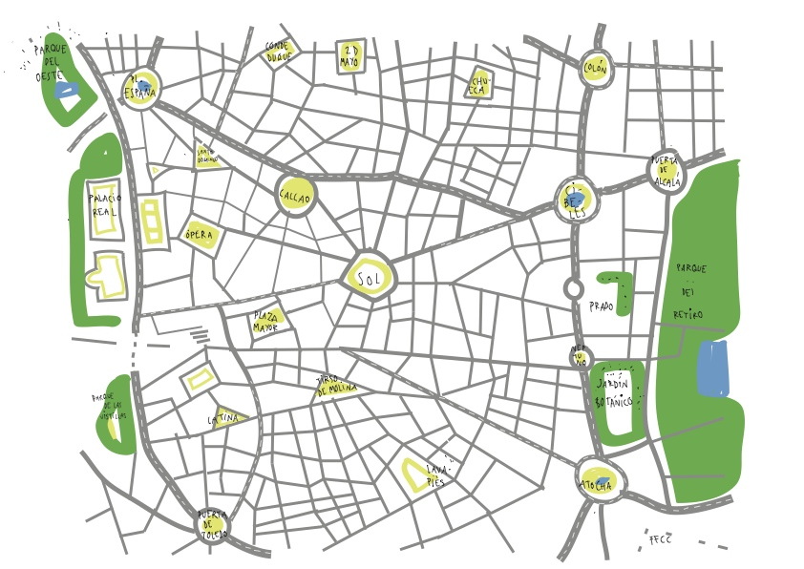
Overall description
Domain properties - these conditions hold in the analyzed world:
the passenger needs a ride to specific location
the details of the ride provided by the passenger are accurate
money exchange between the passenger and the taxi driver is made independently from the myTaxiService system
distinction between the zones are clearly defined
POLITECNICO DI MILANO

Slide 7
Overall description
Constraints
Regulatory policies - will not take advantage of users personal information and will respect the privacy policy
Hardware limitation - access to Internet and own a device with a web browser and GPS service
Interfaces to other applications - Google Maps API, Google Places API and email service in order to make authentication
Parallel operation - support parallel access to the applications database in a transparent way
Assumptions
user have only one account
- user provides accurate information
- if users location is not available, the application will show a screen with an option of typing your current address
- we assume that Google Maps service will calculate location accurately
- taxi driver will respect the ETA, otherwise they could be banned from the system
- if a taxi driver has an unexpected issue, the user will be automatically notified by the system and a new vehicle will be assigned to him with new ETA
POLITECNICO DI MILANO

Slide 8
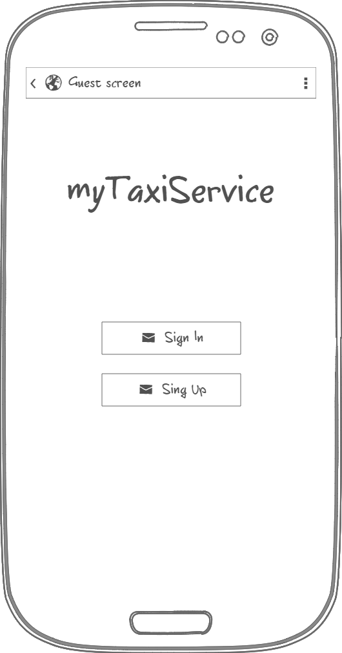
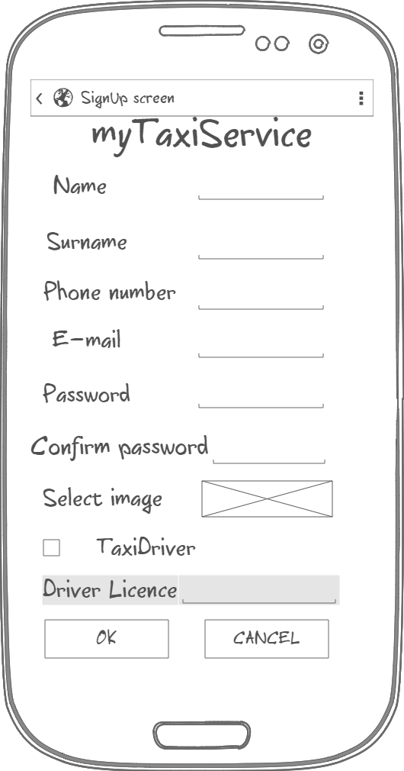
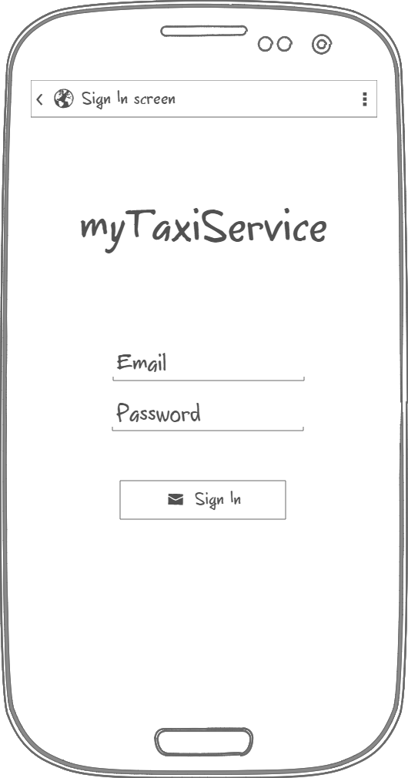
Specific requirements - Mockups
Initial page
Sign Up
Sign In
POLITECNICO DI MILANO

Slide 9
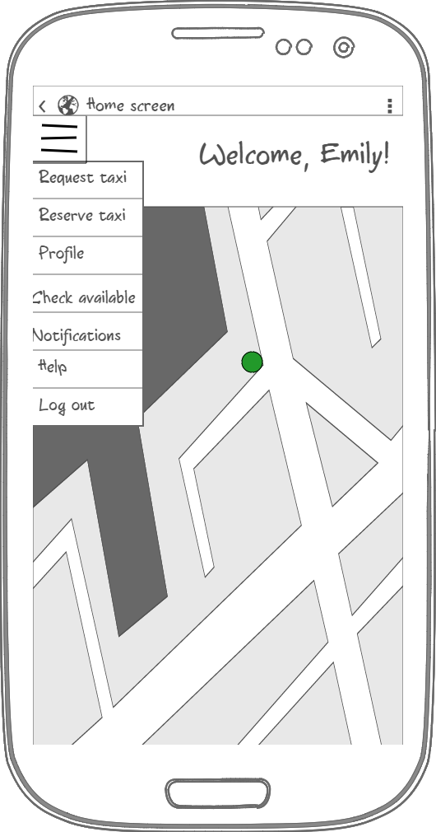
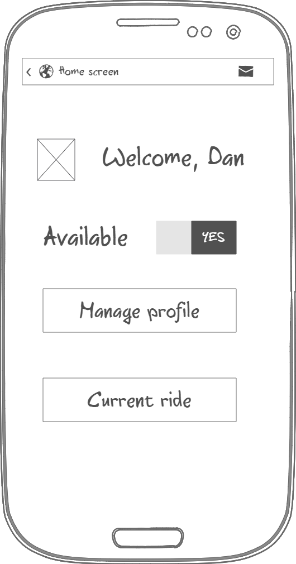
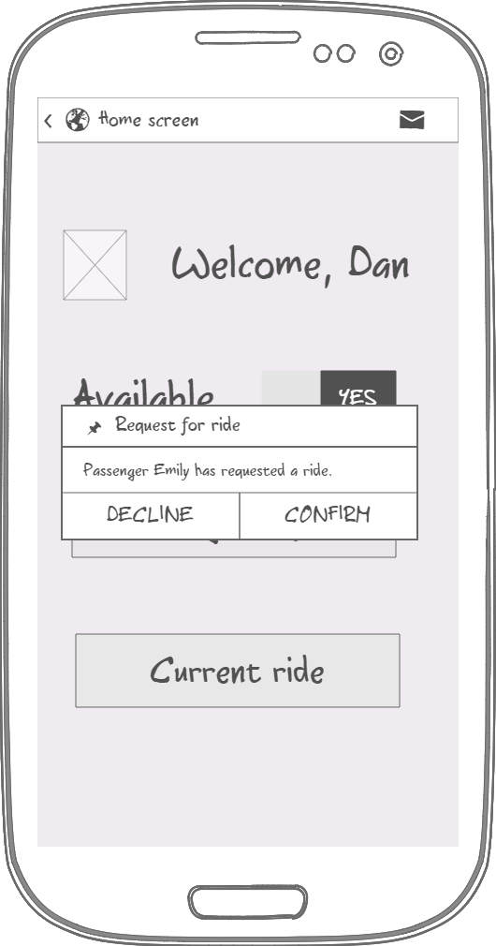
Specific requirements - Mockups
Driver application
Passenger Home page
Driver Home page
Pop up message
POLITECNICO DI MILANO

Slide 10
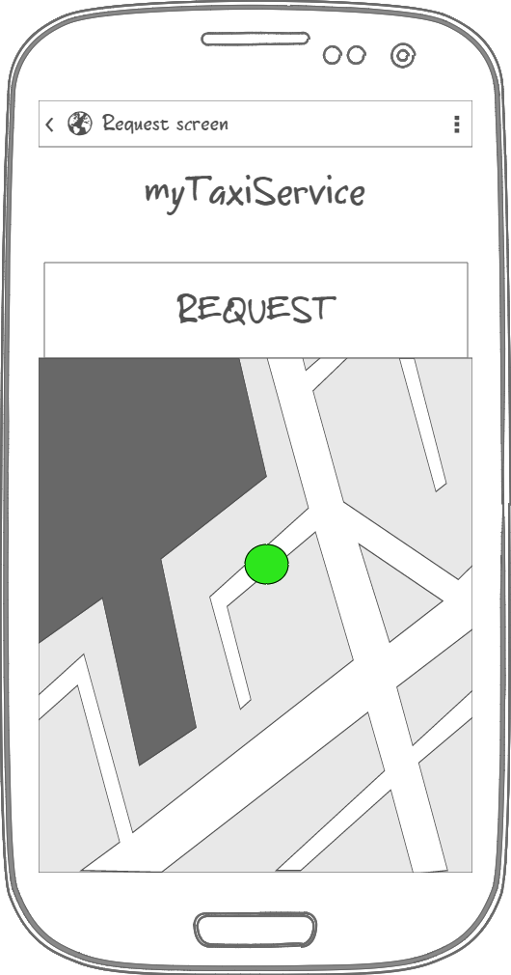
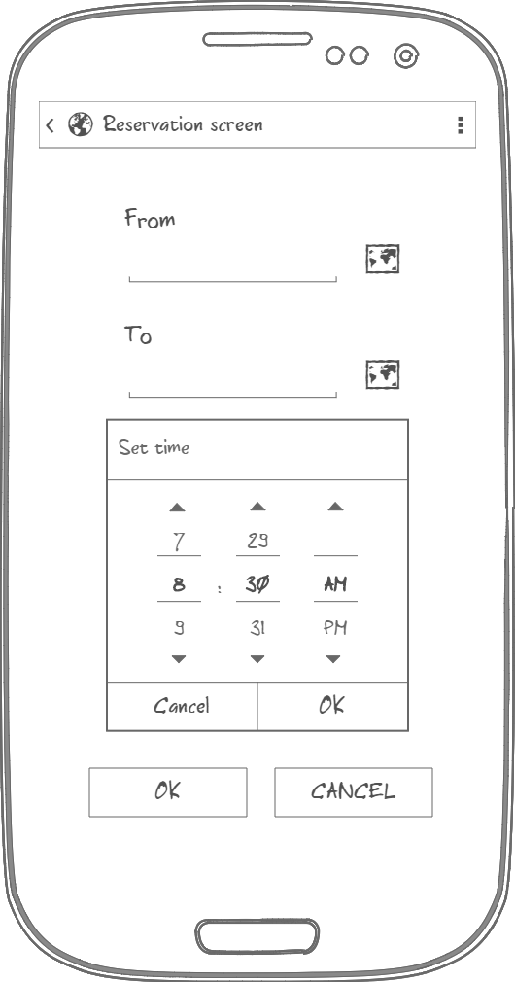
Specific requirements - Mockups
User specify location either by typing address or by choosing it on the map
User specifies address by clicking on the map
Passenger Request page
Passenger Reservation page
POLITECNICO DI MILANO

Slide 11
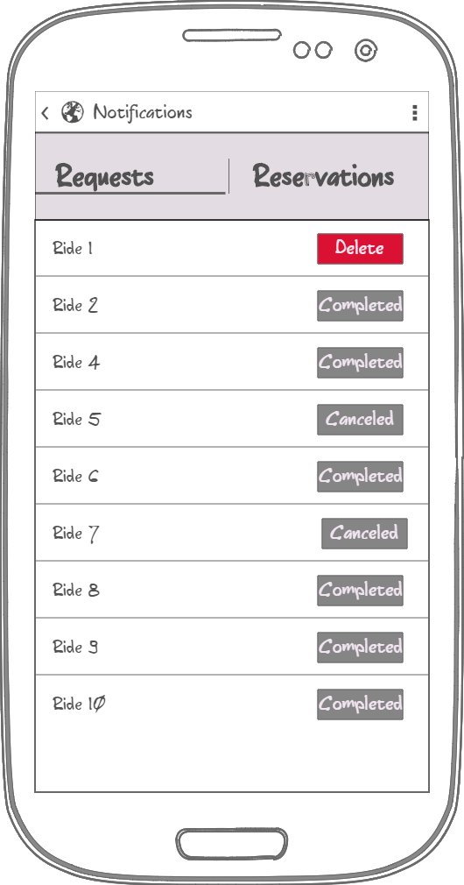
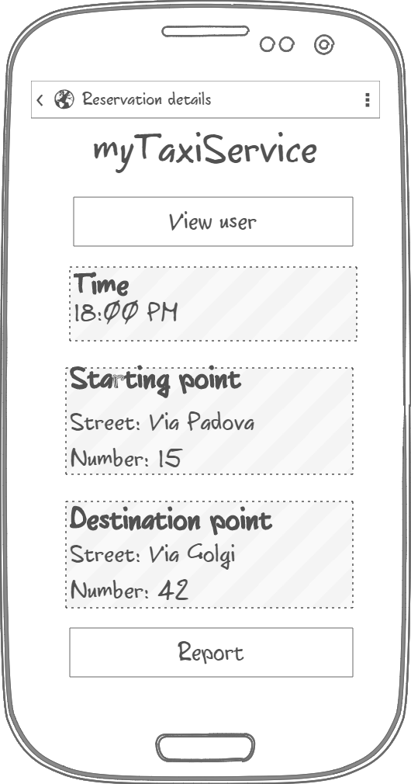
Specific requirements - Mockups
User rides with an option of canceling active ones
Reservation Details page with data
Notification page
Reservation details
POLITECNICO DI MILANO

Slide 12
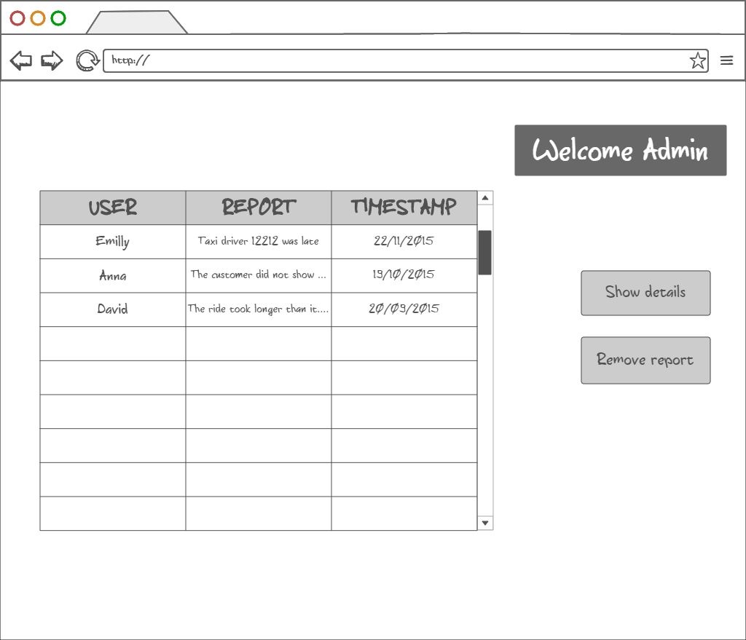
Specific requirements - Mockups
Admin home page
Show details action brings Admin to Report details page
POLITECNICO DI MILANO

Slide 13
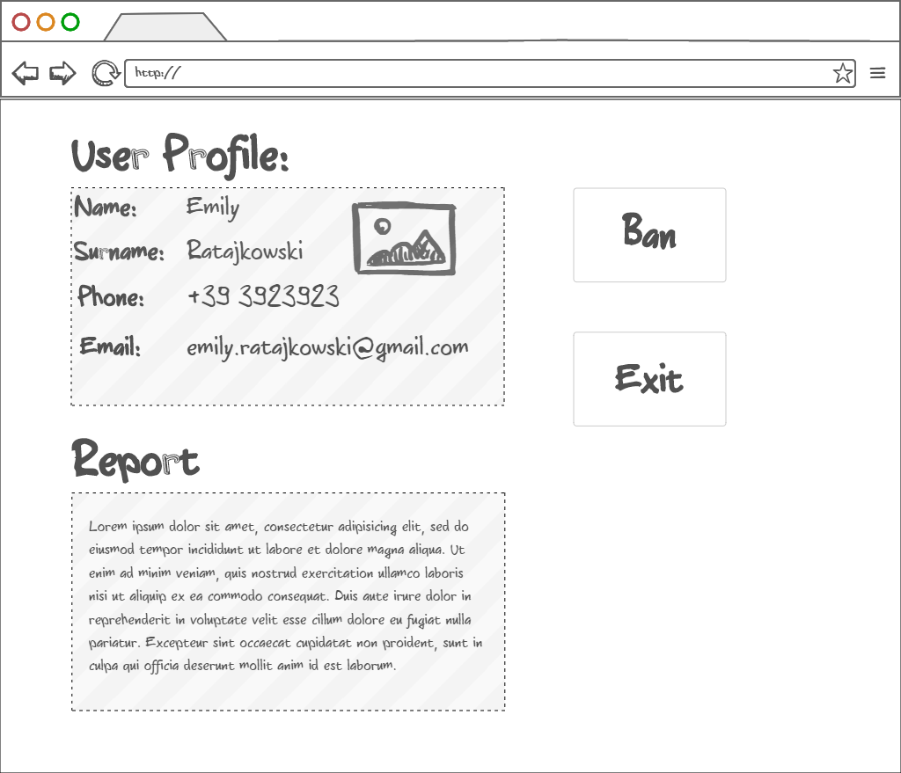
Specific requirements - Mockups
Admin report details page
Information about the user that made the repot
Bans reported user from the system
POLITECNICO DI MILANO

Slide 14
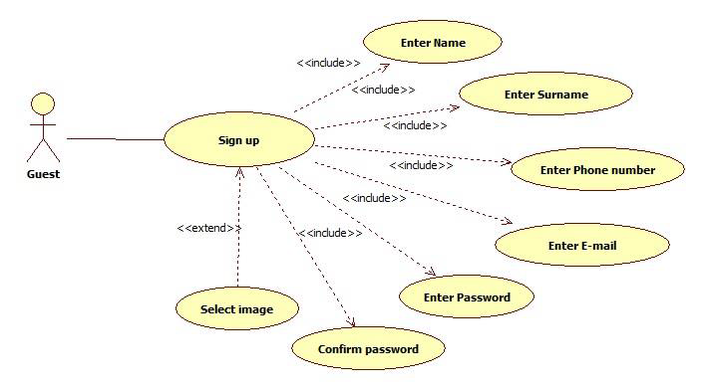
Specific requirements - Use cases
Sign Up use case
POLITECNICO DI MILANO

Slide 15
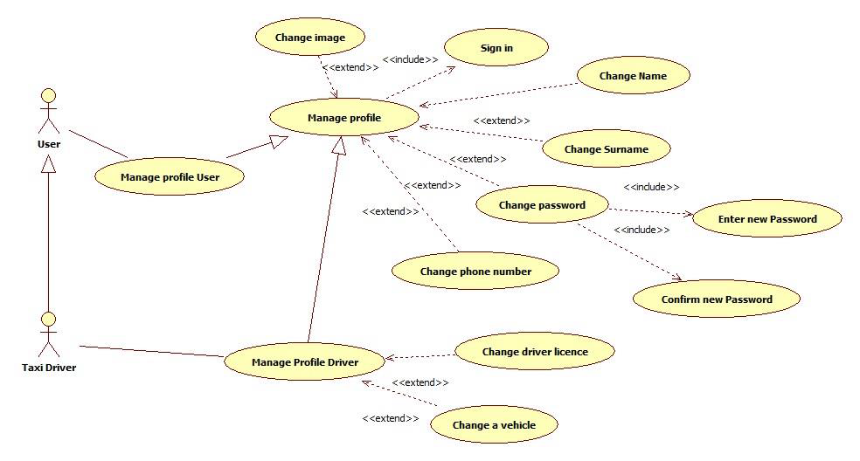
Specific requirements - Use cases
Manage profile use case
POLITECNICO DI MILANO

Slide 16
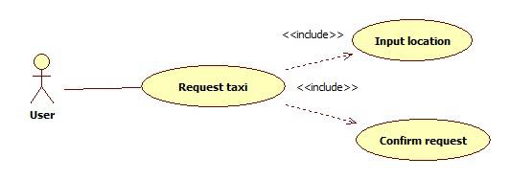
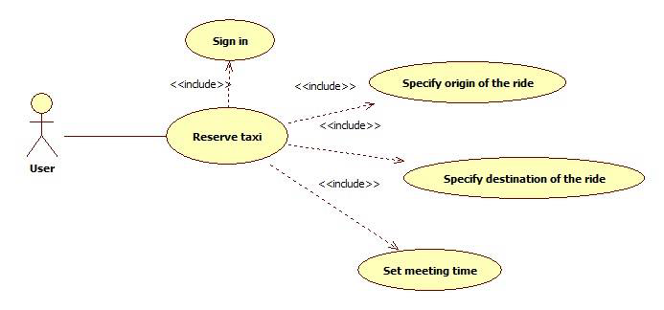
Specific requirements - Use cases
Request / Reserve a taxi use case
POLITECNICO DI MILANO

Slide 17
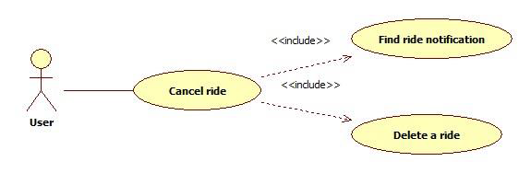
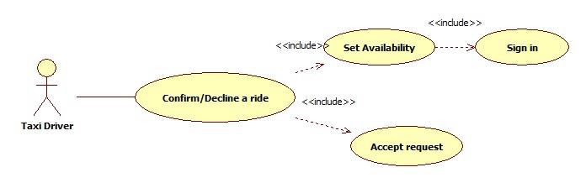
Specific requirements - Use cases
Use cases
Cancel ride use case (passenger)
Confirm/Decline a ride use case
POLITECNICO DI MILANO

Slide 18
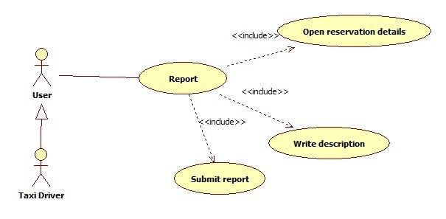
Specific requirements - Use cases
Report use case
POLITECNICO DI MILANO

Slide 19
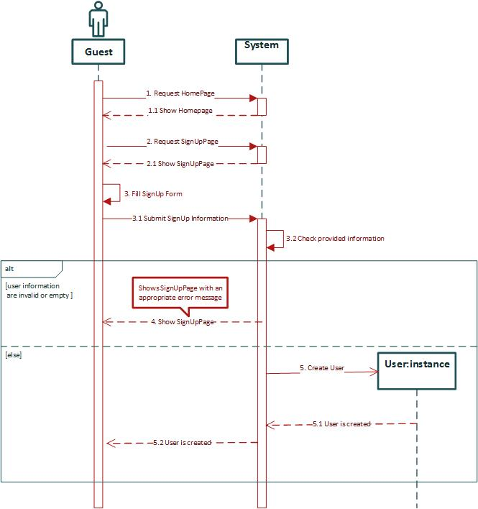
Sign Up sequence diagram
Sign Up sequence diagram
POLITECNICO DI MILANO

Slide 20
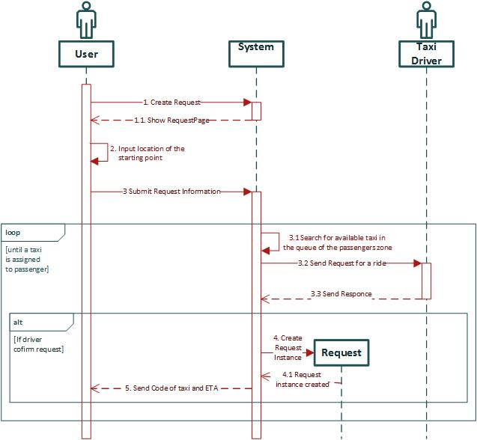
Request a taxi sequence diagram
POLITECNICO DI MILANO

Slide 21
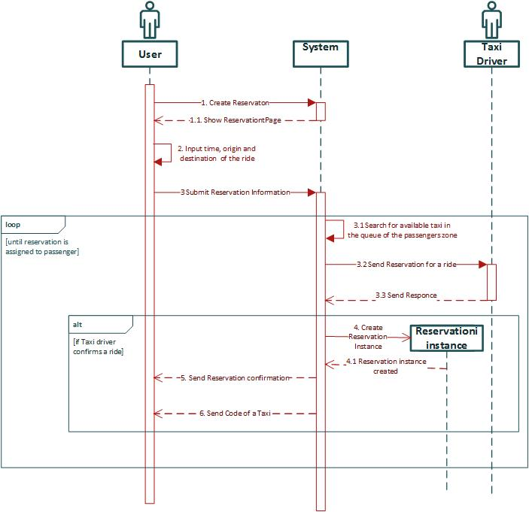
Reserve a taxi sequence diagram
POLITECNICO DI MILANO

Slide 22
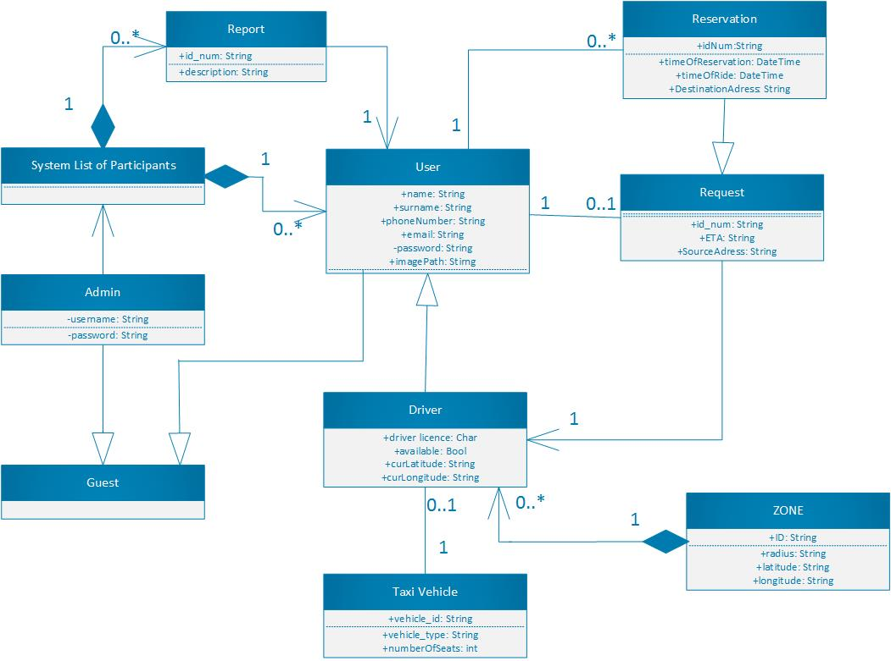
Specific requirements – Class diagram
POLITECNICO DI MILANO

Slide 23
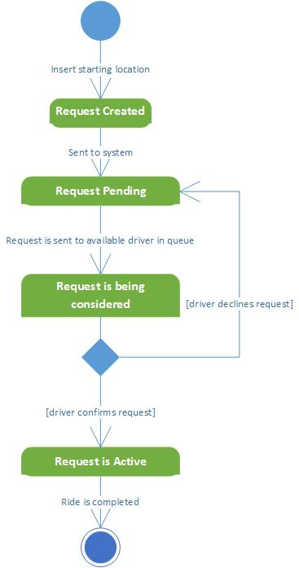
Specific requirements – State Chart diagrams
Request lifecycle
POLITECNICO DI MILANO

Slide 24
Specific requirements – Non functional requirements
Availability
-Application should be available to handle user's request at all times using any device with an installed web browser
Maintainability
- The software system provide specific API for enabling future developers with option to add more services or fix bugs in the system
Portability
- Application could be run on device with any OS that has access to Internet and has a web browser
User Interface
- Web application should be intuitive so even the nontechnical users can use the system as simply and efficiently as possible
POLITECNICO DI MILANO

Slide 25
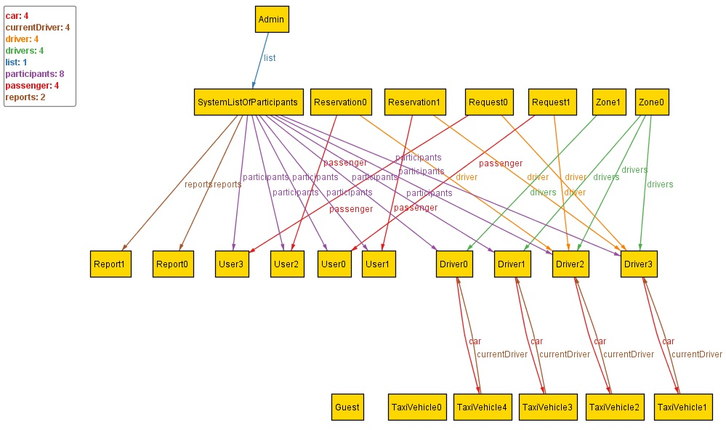
Alloy- World generated by Alloy analyzer
POLITECNICO DI MILANO

Slide 26
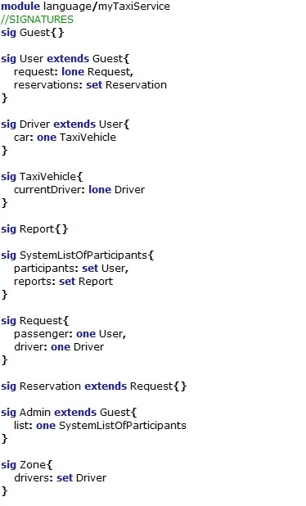
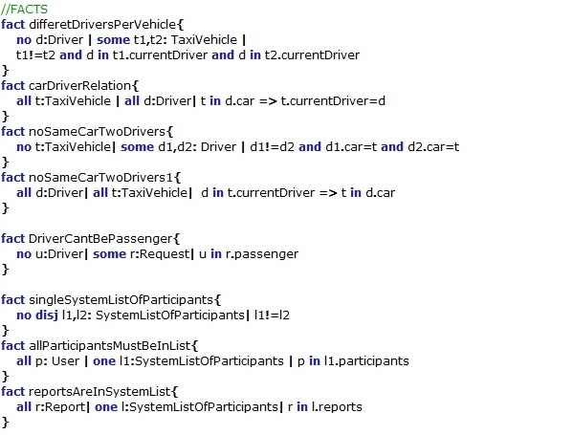
Alloy- Prove the model’s consistency
POLITECNICO DI MILANO

Slide 27
Design Document
Software Engineering 2 – A.Y. 2015/2016
POLITECNICO DI MILANO

Slide 28
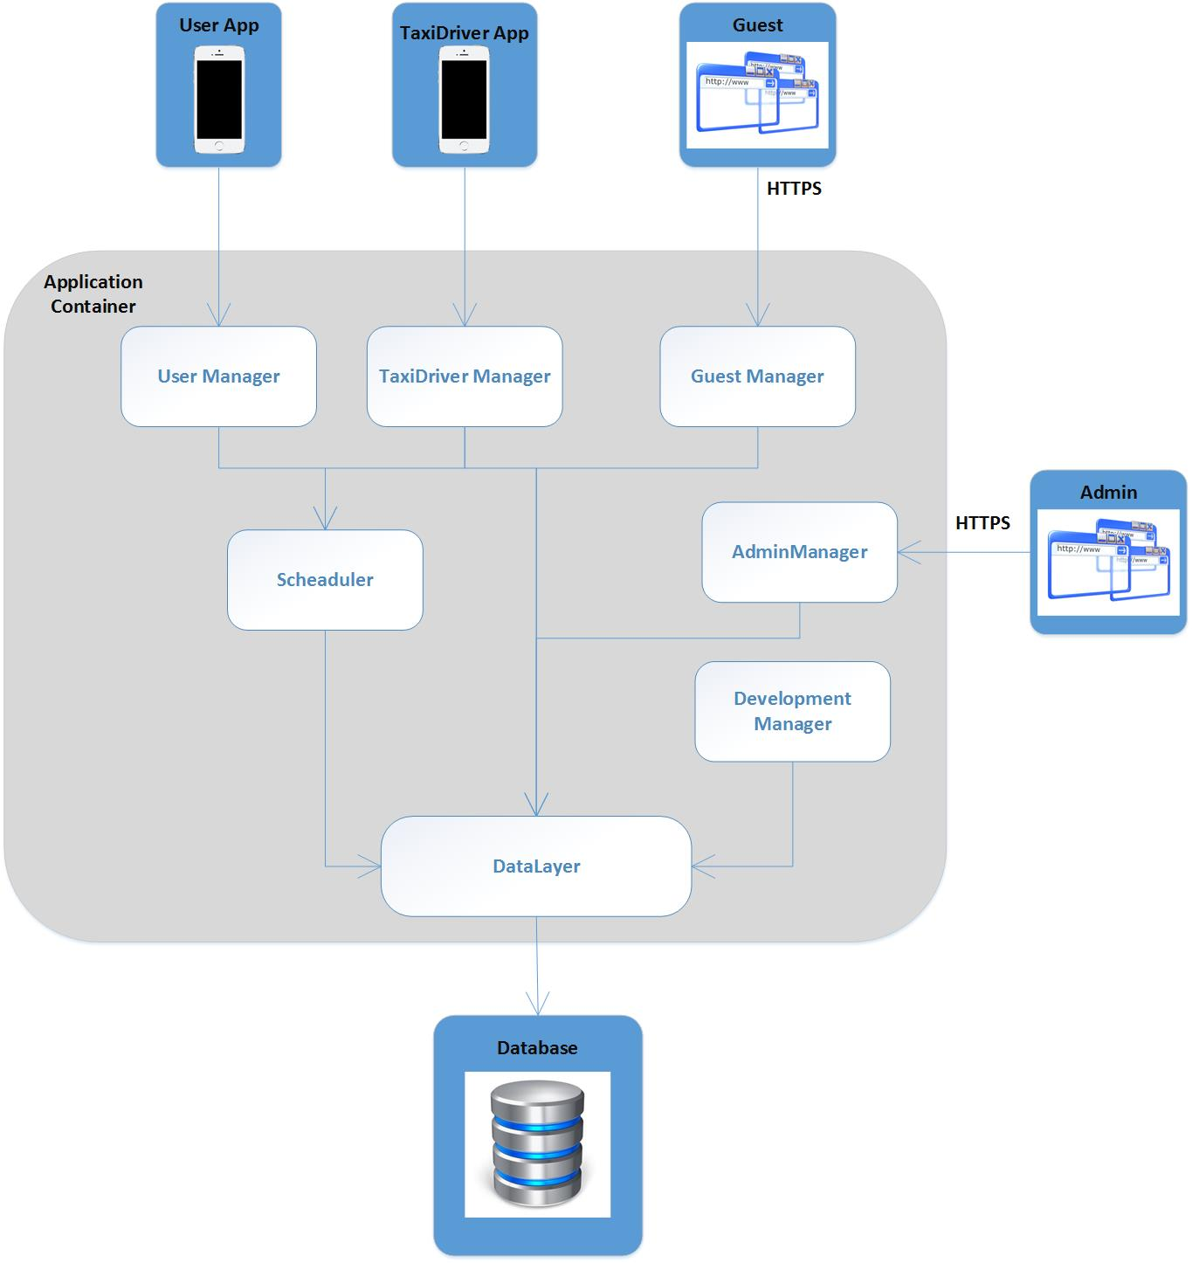
High level components and their interaction
POLITECNICO DI MILANO

Slide 29
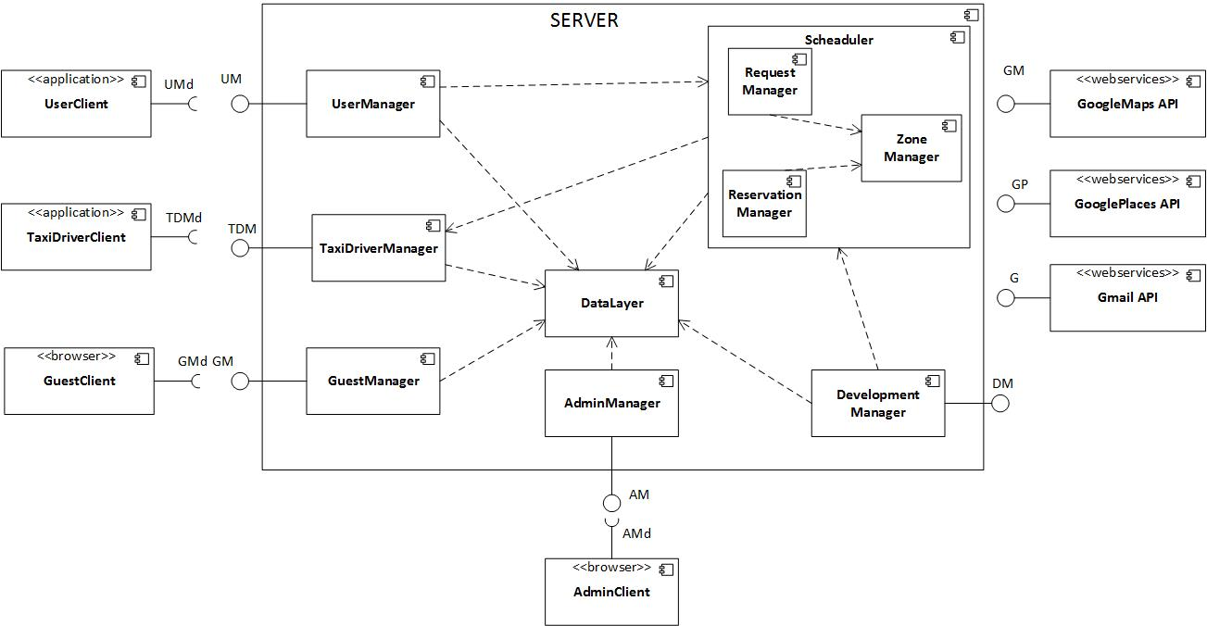
System Components - Overview
POLITECNICO DI MILANO

Slide 30
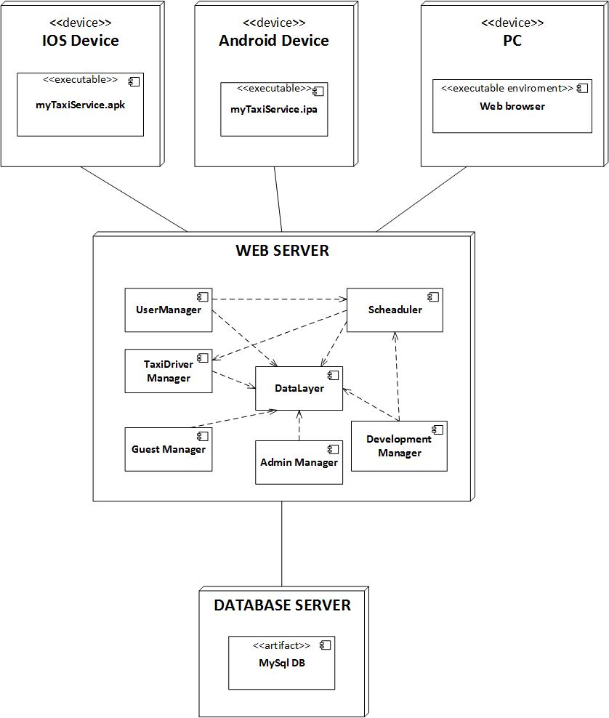
Deployment view
POLITECNICO DI MILANO

Slide 31
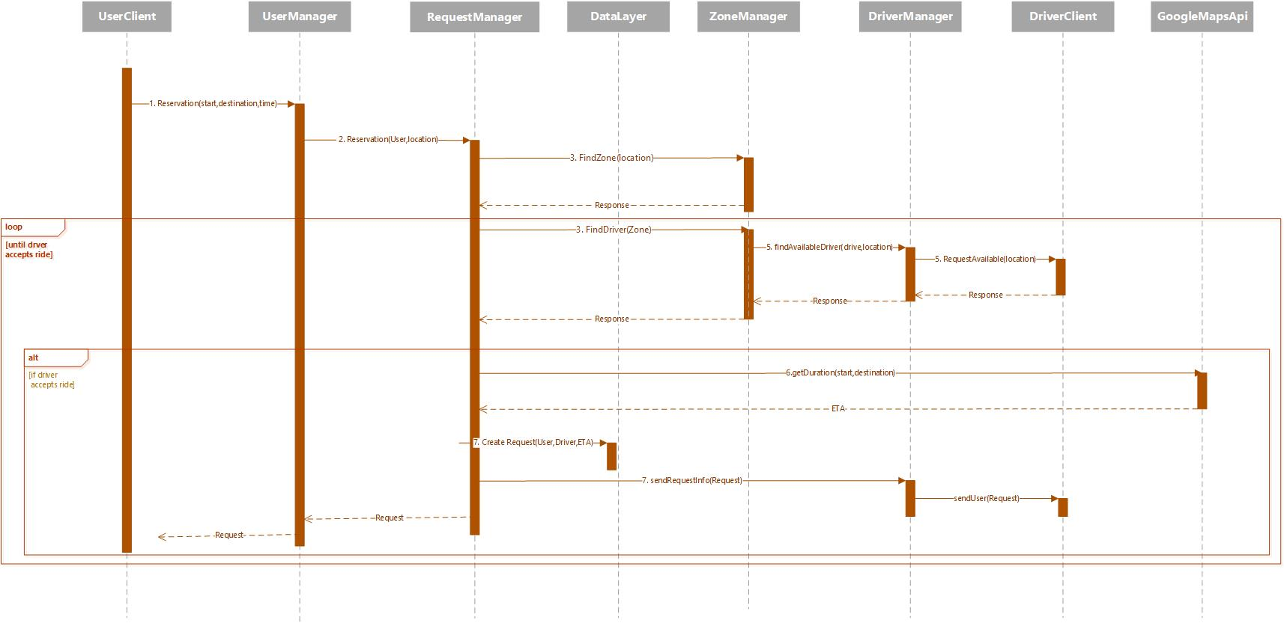
Request – Runtime view
POLITECNICO DI MILANO

Slide 32
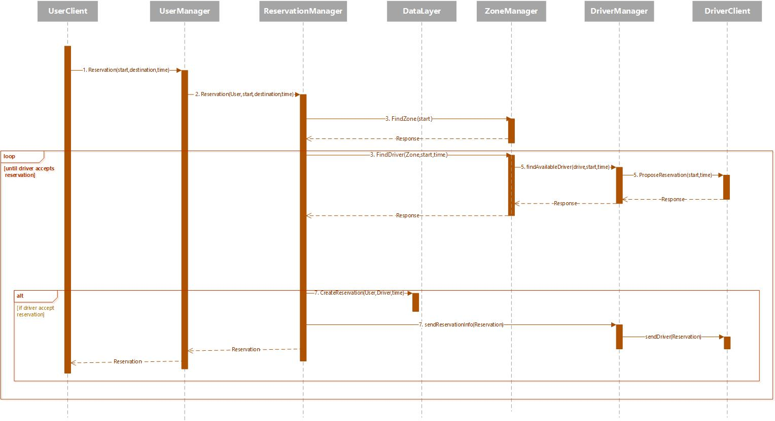
Reservation – Runtime view
POLITECNICO DI MILANO

Slide 33
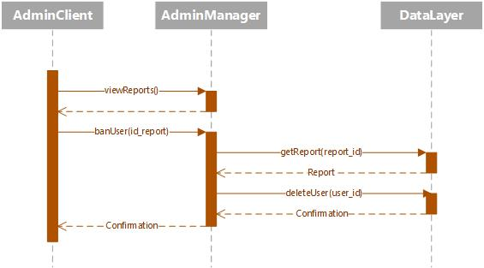
Ban user– Runtime view
POLITECNICO DI MILANO

Slide 34
Component interfaces
Guest Manager
User signUp(name,surname,email,password,phone,img)
User signIn(email,password)
User Manager
Request makeRequest(source_address,user)
Reservation makeReservation(source_address,time_of_ride,destination_address,user)
String report(description,id_user,id_banned)
String manageProfile(user)
TaxiDriver[] checkTaxisAvailable(source_address)
String cancelRide(request)
Taxi Driver Manager
String confirmDeclineRide(request)
String setAvailable(available_bool,id_driver)
Admin Manager
String banUser(id_report)
Report[] viewReports()
POLITECNICO DI MILANO

Slide 35
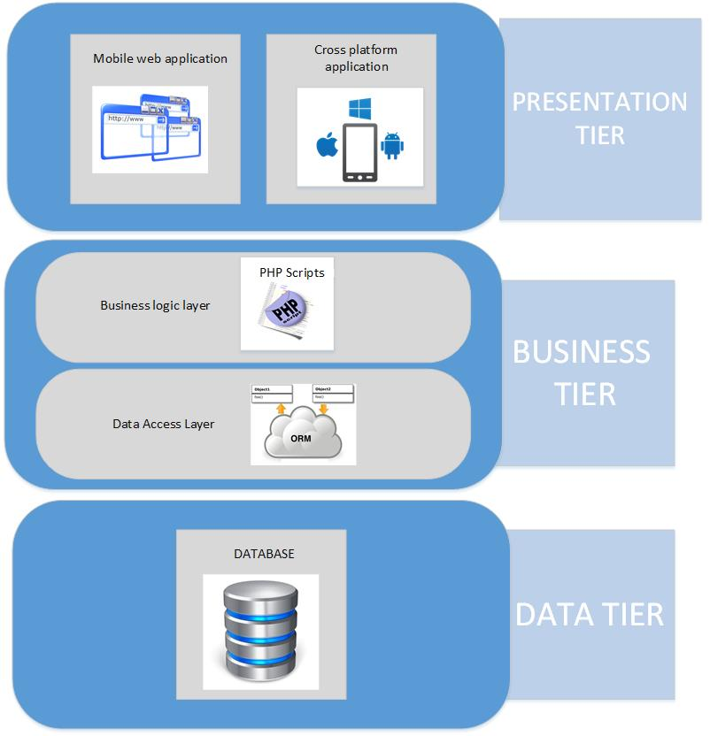
myTaxyService system – Architectural style
POLITECNICO DI MILANO

Slide 36
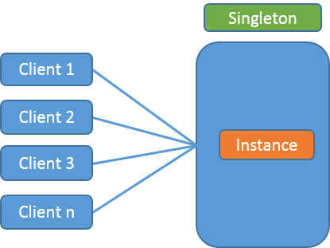
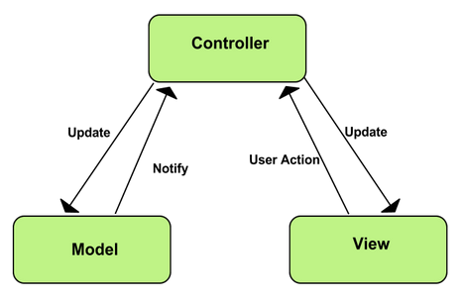
myTaxyService system – Design Patterns
Singleton
MVC
POLITECNICO DI MILANO

Slide 37
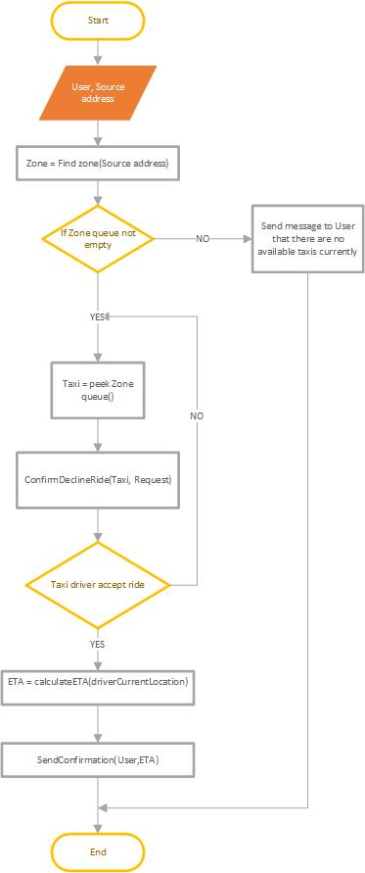
Request Algorithm
POLITECNICO DI MILANO

Slide 38
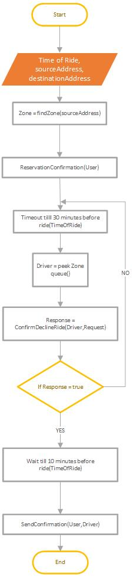
Reservation Algorithm
POLITECNICO DI MILANO

Slide 39
Reservation Algorithm
POLITECNICO DI MILANO

Slide 40
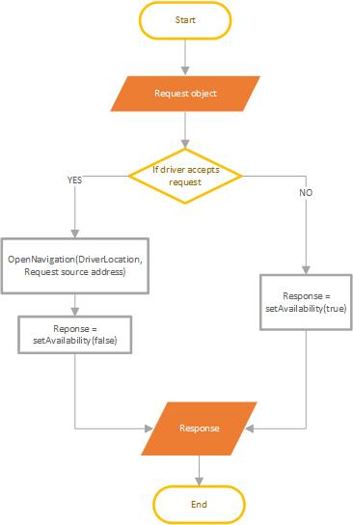
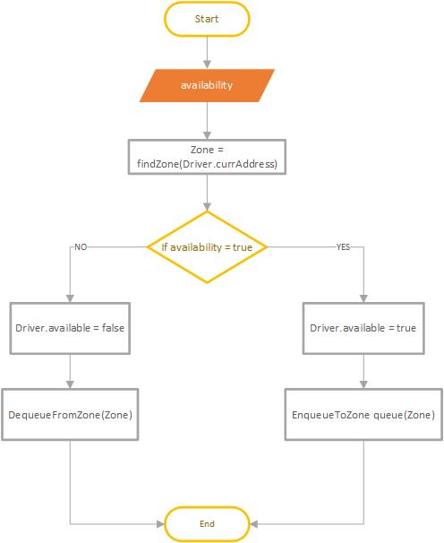
ConfirmDecline and SetAvailability Alghorithms
POLITECNICO DI MILANO

Slide 41
Requirement traceability
Functional requirements | Components
1.-2.UseCase: Accessing the application- Sign Up and Sign In | Guest Manager, Data Layer
3.UseCase: Manage Profile for user and driver | User Manager, Taxi Driver Manager, Data Layer
4.UseCase: Requesting a taxi | User Manager, Scheduler, Taxi Driver Manager, Data Layer, Google Maps API, Google Places API
5.UseCase: Reserving a taxi | User Manager, Scheduler, Taxi Driver Manager, Data Layer, Google Places API
6.UseCase: Canceling a ride | User Manager, Data Layer, Taxi Driver Manager, Scheduler
7.UseCase: Confirm/Decline a ride | Scheduler, Driver Manager , Google Maps API
8.UseCase: Check Taxis Available | User Manager, Scheduler, Google Maps API, Data Layer
9.UseCase: Report user/driver | User Manager or Driver Manager, Data Layer
10.UseCase: Ban user/driver | Admin Manager, DataLayer
POLITECNICO DI MILANO

Slide 42
Integration Test Plan
Software Engineering 2 – A.Y. 2015/2016
POLITECNICO DI MILANO

Slide 43
System Components - Overview
POLITECNICO DI MILANO

Slide 44
Functions that have to pass unit testing 1/2
Component | Functions to be unit tested
Guest Manager | signUp() signIn()
User Manager | makeRequest() makeReservation() report() manageProfile() checkTaxisAvailable() checkReservation() cancelRide()
TaxiDriver Manager | confirmDeclineRide() setAvailable() manageProfile() report() cancelRide() checkRides()
Admin Manager | banUser() viewReports() signIn()
Scheduler
POLITECNICO DI MILANO

Slide 45
Functions that have to pass unit testing 2/2
Component | Functions to be unit tested
Request Manager | createRequest() provideTaxi() calculateETA() sendConfirmation() findZone() findDriver() rideProposal()
Reservation Manager | createReservation() findDriver() findZone() sendConfirmation() reservationConfirmation() rideProposal()
Zone Manager | determineZone() //getZone findAvailableDriver() enqueDriver() dequeueDriver() peekDriverOnQueue()
POLITECNICO DI MILANO

Slide 46
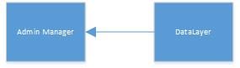
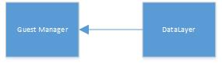
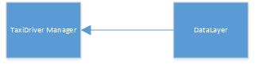
Elements to be integrated 1/3
Admin Component
Guest Component
Taxi Driver Component
POLITECNICO DI MILANO

Slide 47
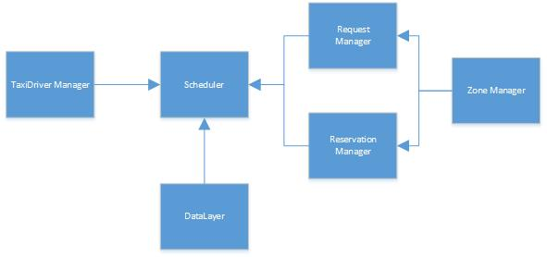
Elements to be integrated 2/3
Scheduler Component
POLITECNICO DI MILANO

Slide 48
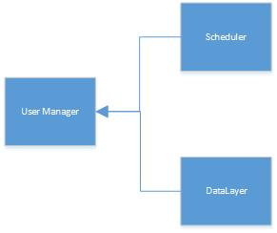
Elements to be integrated 3/3
User Component
POLITECNICO DI MILANO

Slide 49
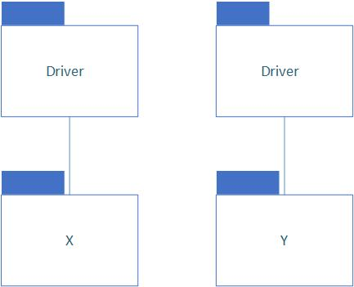
Integration Strategy – Bottom up
bottom-up approach
start from the lowest levels of the system (functions) that have passed the unit testing
good overview of how far have we gone with the integration testing
spot the problems in lower levels
POLITECNICO DI MILANO

Slide 50
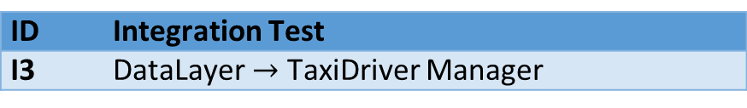


Software Integration Strategy 1/2
ID | Integration Test
I1 | DataLayer $→$ Guest Manager
ID | Integration Test
I2 | DataLayer $→$ Admin Manager
ID | Integration Test
I3 | DataLayer $→$ TaxiDriver Manager
Integration Test for:
Guest Component
Admin Component
TaxiDriver Component
POLITECNICO DI MILANO

Slide 51

Software Integration Strategy 2/2
ID | Integration Test
I4 | Zone Manager $→$ Request Manager, Reservation Manager
I5 | Request Manager, Reservation Manager, TaxiDriver Manager, DataLayer $→$ Scheduler
ID | Integration Test
I6 | DataLayer, Scheduler $→$ User Manager
Integration Test for:
Scheduler Component
User Component
POLITECNICO DI MILANO

Slide 52

Subsystem Integration
ID | Integration Test
I7 | Guest Manager, Admin Manager, User Manager, Scheduler $→$ myTaxiSevice system
POLITECNICO DI MILANO

Slide 53

Test Cases Specification - Example
Test Case Identifier | I7T1
Test Item(s) | Data Layer$→$ User Manager
Input Specification | Create typical DataLayer input as DB connection
Output Specification | Check if the correct functions are called in User Manager
Environmental Needs | N/A
Purpose | This test case checks whether the call made by user (User Manager) work as expected: report() manageProfile() checkTaxisAvailable() checkReservation() cancelRide()
POLITECNICO DI MILANO

Slide 54

Test Cases Specification - Example
Test Case Identifier | I7T2
Test Item(s) | Scheduler$→$ User Manager
Input Specification | Create typical Scheduler input
Output Specification | Check if the correct functions are called in User Manager
Environmental Needs | I6 succeeded
Purpose | This test case checks whether the call made by user (User Manager) work as expected: makeReservation() makeRequest ()
POLITECNICO DI MILANO

Slide 55
Test Procedures - Example
Test Procedure Identifier | TP5
Purpose | This test procedure verifies whether the User component: Can handle User input Can output information to Scheduler Return correct information to the User
Procedure Steps | Execute I7 after I6
POLITECNICO DI MILANO

Slide 56
Tools and Test Equipment
Manual Test
Implementation is splitted by user stories
Integration testing is done manually by the same team member who has implemented it
Then it is tested by other team member to ensure that all the requirements are met
Automatic Test
save time in long term: it can be
run in every moment
everybody can check reports
“Cucumber”
“Watir-Webdriver”
Used programming language for writing the code for test cases is Ruby
POLITECNICO DI MILANO

Slide 57
Program Stubs and Test Data Required
Test database:
sample user data
External Google API stub:
external GoogleMaps and GooglePlaces API system
TaxiDriverManager component - perform navigation
UserManager component - pick destination address and see available taxi vehicles on the map
External Gmail stub:
external Gmail system
GuestManager component - signUp procedure
Drivers:
used for components not available yet for the integration test phase
replaced with appropriate drivers
POLITECNICO DI MILANO

Slide 58
Project Plan
Software Engineering 2 – A.Y. 2015/2016
POLITECNICO DI MILANO

Slide 59
Functional points - Brief introduction
Function Types |  | Weight
 |  | Low | Average | High
N.Inputs |  | 3 | 4 | 6
N.Outputs |  | 4 | 5 | 7
N.Inquiry |  | 3 | 4 | 6
N.ILF |  | 7 | 10 | 15
N.EIF |  | 5 | 7 | 10
Weighting Function Points
Language | SLOC/FP
JS | 47
HTML | 34
PHP | 67
Total: | 148
Programming Language SLOC correlation
POLITECNICO DI MILANO

Slide 60
Internal logic files
ILF | Complexity | FP
User | Average | 10
Driver | Average | 10
Request | Low | 7
Reservation | Average | 10
Report | Low | 7
Taxi Vehicle | Low | 7
Zone | Low | 7
Admin | Low | 7
Total: |  | 65
POLITECNICO DI MILANO

Slide 61
External interface files
EIF | Complexity | FP
Google Maps API | High | 10
Google Places API | Average | 7
Gmail | Low | 5
Total: |  | 22
POLITECNICO DI MILANO

Slide 62
External inputs
Clients |  | Function | Complexity | FP
Guest |  | signUp() signIn() | Low Low | 3 3
User |  | report() manageProfile() cancelRide() | Low Average Low | 3 4 3
Driver |  | setAvailable() manageProfile() report() cancelRide() | Low Average Low Low | 3 4 3 3
Admin |  | banUser() signIn() | Average Low | 4 3
Total: |  |  |  | 36
POLITECNICO DI MILANO

Slide 63
External inquires
Clients |  | Function | Complexity | FP
User |  | makeRequest() makeReservation() checkTaxisAvailable() checkReservation() | High High Low Low | 6 6 3 3
Driver |  | confirmDeclineRide() checkRides() | Average Average | 4 4
Admin |  | viewReports() | Low | 3
Total: |  |  |  | 29
POLITECNICO DI MILANO

Slide 64
External outputs
Notification - sent to driver after user request a taxi
Acknowledgement – sent to user after driver accepts a ride
Notification - sent to user after successful reservation
All three outputs considered high weight, and estimation is:
3*7=21 FP
POLITECNICO DI MILANO

Slide 65
Total FPs
Function Type |  | Number of FP
ILF |  | 65
EIF |  | 22
EI |  | 36
EIQ |  | 29
EO |  | 21
Total: |  | 173
POLITECNICO DI MILANO

Slide 66

Effort Estimation COCOMO II
EAF - Effort Adjustment Factor derived from Cost Drivers – 0.72
$$E=0.91+0.01∗\left(PREC+FLEX+RESL+TEAM+PMAT\right)=1.1028$$
$Effort=2.94∗EAF∗{(KSLOC)}^{E}$ = $22.71 Person/Months$
$$F=0.28+0.2∗\left(E−0.91\right)=0.31856$$
$$Duration=3.67∗{22.71}^{0.31856}=9.92 Months$$
$$People=\frac{Effort}{Duration}=2.29 People$$
POLITECNICO DI MILANO

Slide 67

Task allocation - Gantt chart
POLITECNICO DI MILANO

Slide 68
Risk Management
Risk Description |  | Risk Mitigation |  | Risk Priority
Lack of communication between all the team members |  | The team should meet at least once a week |  | High
Underestimate project workload |  | The team should discuss about project scope in every meeting |  | Medium
The developed solution doesn’t fit the final user’s needs |  | During the requirement specification, team should do some surveys and interviews to find what the users are looking for |  | High
Application reliability and usability |  | The team should develop with good practices and develop a list of acceptance tests |  | Medium
POLITECNICO DI MILANO

Slide 69
Future possible implementation
Online payment
Option of rating the drivers
Facebook authentication
Taxi sharing options
POLITECNICO DI MILANO

Slide 70
Inspection document
Software Engineering 2 – A.Y. 2015/2016
POLITECNICO DI MILANO

Slide 71
Assigned funcitons- Overview
findClassInternal(String name) - find specified class in local repo
findResourceInternal(String name, String path) – find specified resource in local repository
findResourceInternalFromRepositories(String name, String path) - tries to find and load specified resource from internal repositories of the class
POLITECNICO DI MILANO

Slide 72
Some exceptions found - findClassInternal
Wrapping lines
Checklist point | Issue | Line | Details
15 | Line break is not correct | 2788 | Line is separated before an operator “II”
15 | Line break is not correct | 2793 | Line is separated before an operator “+”
16 | High level break is present in this function | 2792-2794 | Break doesn’t occur after coma or an operator.
Exceptions
Checklist point | Issue | Line | Details
53 | Exception is not caught | 2792 | SecurityException is thrown and is not properly handled in the function, and it is neither stated in the function declaration.
POLITECNICO DI MILANO

Slide 73
Some exceptions found - findResourceInternal
Indention
Checklist point | Issue | Line | Details
8 | More spaces used for indention | 2827 | Line has 4 spaces more that it should have
Initialization and Declarations
Checklist point | Issue | Line | Details
33 | Declarations at the beginning of block | 2835 and 2859 | Line 2835 – entry variable is not declared in the beginning of block of code Line 2859 – entry2 variable is not declared in the beginning of block of code
POLITECNICO DI MILANO

Slide 74
Some exceptions found- findResourceInternalFromRepositoriesnd
Initialization and Declarations
Checklist point | Issue | Line | Details
32 | Variable not initialized | 2924 | Variable j is declared as int but not initialized on the spot
33 | Declarations at the beginning of block | 2881 to 2885, 2907 and 2934 | Declarations at those lines are not on the beginning of the block.
Exceptions
Checklist point | Issue | Line | Details
53 | Exception is not properly handled | 2943 | Catch block is empty, exception is not handled
POLITECNICO DI MILANO

Slide 75

Questions?
Thank you for your attention
POLITECNICO DI MILANO

